Slide 1




NEC YOLO-HF
MEETS

Slide 2
Department of Computer Science and Engineering
YOLO-HF: A Compact System for Fire Detection and Alerting
PRESENTED BY
Yaswanth Gunda | 22471A0592
Ranjith Kumar Garikapati | 22471A0589
Bala Muneendra Chilaka | 22471A05A8
Tarun Bellamkonda | 22471A0576
Under the Guidance of,
Dr.S.N.Tirumala Rao _{M.Tech , Ph.D. ,}
Professor & HOD,
Department of Computer Science and Engineering,
Narasaraopeta Engineering College (Autonomous),
Narasaraopet- 522 601.

Slide 3
OUTLINE
Abstract
Introduction
Literature Survey
Research Gaps
Problem Statement
Objectives
Block Diagram / Flow Diagram
Methodology
Implementation
Results and Analysis
Conclusion & Future Scope
References
Acknowledgements
Question and Answers

Slide 4
ABSTRACT
Early fire and smoke detection is crucial to prevent damage and save lives. Traditional sensors are often slow and unreliable. Our solution, YOLO-HF, is an improved real-time detector built on YOLOv5s with added modules like PBCA, SPD, CBPS, and RepNCSPELAN4 to boost feature learning and accuracy
We trained the model on 3,900 diverse fire and smoke images after careful data cleaning. YOLO-HF achieved mAP@0.5 = 92.3%, Precision = 93.7%, and Recall = 91.4%, outperforming the baseline YOLOv5s.
It works with a mobile camera feed, and when fire is detected, it captures an image, sends an email alert, and triggers an automated phone call using Twilio. This makes it ideal for homes, industries, and forest monitoring, ensuring quick and reliable emergency response.

Slide 5
INTRODUCTION
Brief Introduction to the Project
YOLO-HF is a real-time fire and smoke detection system built on YOLOv5s, enhanced with lightweight modules for better accuracy. It was trained on 3,900 diverse images and can send instant alerts through email and phone call when fire is detected.
Motivation Behind the Project
Traditional fire alarms can be slow or give false alerts. Using deep learning allows faster, more accurate detection, helping reduce damage and save lives.
Importance and Relevance
The system is useful for homes, industries, and outdoor monitoring, providing quick emergency response and improving overall safety.

Slide 6
LITERATURE SURVEY
S.No | Title | Author | Journal Name & Year | Methodology Adapted | Key Findings | Gaps
1 | Fire and Smoke Detection Based on Improved YOLOV11 | Zhipeng Xue,Lingyun Kong,Haiyang Wu. | IEEE & 2025 | YOLOv11-DH3 (Improved YOLOv11) DCNv2 replaced with DCNv3 in detection head CIOU replaced with IOU as loss function | YOLOv11-DH3 improves detection by replacing: DCNv2 → DCNv3: Better geometric adaptability. CIOU → IOU: Simplifies training, improves generalization. 58% mAP@0.5 (↑1.4%) on Baidu Paddle dataset. F1-score: 58% (↑2%) Precision: 91.6%, Recall: 90% | Scene Dependency: Works well in complex close-range, not in long-range scenes DCNv3: High computational cost, less effective for small smoke targets CIOU vs IOU: CIOU suits small/regular targets; IOU suits diverse/irregular targets
2 | FDN: A Real-Time Ensemble Fire Detection Network | Dong Hwan Shin,Jang Mook Kang,Taesu Cheong. | IEEE & 2025 | FDN (FireDetectNet) Classification: ResNeXt-50 (32×4d), EfficientNet-B4 Detection: YOLOv5s Uses ensemble technique with P-LBTW | FDN (FireDetectNet): Ensemble model combining classification + detection Multi-label approach handles overlapping objects better Introduced Partial-Loss-Balanced Task Weighting (P-LBTW): Improves detection/classification balance | Only classify fire/smoke vs non-fire Can't handle fog, clouds, sunlight, or artificial light Fail in low visibility or overlapping fire/smoke scenes Classification and detection are not combined
3 | YOLOV9-CBM: An Improved Fire Detection Algorithm Based on YOLOV9 | Xin Geng,Xiao Han,Xianghong Cao. | IEEE & 2025 | YOLOv9-CBM (custom YOLOv9) C3-SE module with SE attention BiFPN for better feature fusion MPDIoU as loss function | Proposed YOLOv9-CBM improves over YOLOv9 with: C3-SE module (adds SE attention to C3, replaces RepNCSPELAN4) BiFPN replaces PANet for better multi-scale feature fusion | Poor generalization to complex lighting/smoke conditions Inefficient feature fusion with PANet CIoU limitations in bounding box accuracy

Slide 7
LITERATURE SURVEY
S.No | Title | Author | Journal Name & Year | Methodology Adapted | Key Findings | Gaps
4 | GSF-YOLOv8: A Novel Approach for Fire Detection Using Gather-Distribute Mechanism and SimAM Attention | Caixiong Li,Dali Wu.,Xing Zhang,Peng Wu. | IEEE & 2025 | Gather-Distribute (GD): Improves multi-scale feature fusion SimAM Attention: Enhances spatial and channel attention without hyperparameters Focal-DIoU Loss: Improves localization accuracy | Enhanced YOLOv8 (GSF-YOLOv8) Improvements: GD fusion, SimAM attention, Focal-DIoU loss Learning Type: CNN-based object detection Innovation: Lightweight attention with high-speed real-time detection | Weak feature fusion Poor small object detection High false/miss detection ratesGD mechanism for better deep & shallow fusion SimAM for lightweight 3D attention
5 | Constructing a Lightweight Fire and Smoke Detection Through the Improved GhostNet Architecture and Attention Module Mechanism | Wen-Tsai Sung,Indra Griha Tofik Isa,Ching-Hsiang Tseng. | IEEE & 2025 | YOLOv8m (base model) iGhostNet: Improved GhostNet with Coordinate Attention CBAM: Convolutional Block Attention Module | Model Architecture: YOLOv8m + iGhostNet + CBAM Dataset: 13k custom images of fire, smoke, and people Accuracy: 97.3% mAP@0.5, 97.7% precision, 95.2% recall Size: 53.18 MB (lightweight) | Model performance may drop in extreme lighting or fog Needs more validation across different domains (forest, indoor, industry) Training code and pre-trained models are not provided
6 | Real-Time Detection of Forest Fires Using FireNet-CNN and Explainable AI Techniques | Gazi Mohammad Imdadul Alam,Naima Tasnia,Tapu Biswas. | IEEE & 2025 | FireNet-CNN,Custom CNN,Grad-CAM and Saliency Maps | Model Name: FireNet-CNN Model Type: Convolutional Neural Network (CNN) Accuracy: Up to 99.05% | Low accuracy in real-time forest environments Black-box CNNs lack interpretability Not enough data for rare fire events High computational load during deployment

Slide 8
LITERATURE SURVEY
S.No | Title | Author | Journal Name & Year | Methodology Adapted | Key Findings | Gaps
7 | Mirror Target YOLO: An Improved YOLOv8 Method With Indirect Vision for Heritage Buildings Fire Detection | Jian Liang,Junsheng Cheng. | IEEE & 2025 | MITA-YOLO (Mirror Target YOLO) Based on YOLOv8n with 2 main innovations: Indirect Vision: Mirror-based scene coverage | MITA-YOLO (Mirror Target YOLO) is introduced: Uses mirrors to expand camera field of view in irregular spaces. Introduces Target-Mask Module: Filters out irrelevant regions. Focuses only on mirror-based target zones. | Fire detection in irregular heritage buildings is limited by Narrow camera vision Structural damage caused by sensor installation Noise interference from non-interest areas
8 | Deep Learning-Based Rapid Fire Detection in Buildings Using Acoustic Wave Travel Time Information | Mengyao Sun,Cewen Liu. | IEEE & 2025 | ResNet50: Clean AI model ResNet50 (Noise-trained): Trained with 5% noise | ResNet50 is used for direct TOF to temperature mapping Prediction time: <1 second (vs ~34.2 sec for traditional methods) No parameter tuning needed Noise-trained model is more robust | Only single fire source modeled, no multi-source detection Assumes empty room, no real-world obstructions like furniture 2D environment only, not extended to 3D spaces

Slide 9
LITERATURE SURVEY
S.No | Title | Author | Journal Name & Year | Methodology Adapted | Key Findings | Gaps
9 | YOLO-DKM: A Flame and Spark Detection Algorithm Based on Deep Learning | Linpo Shang,Xufei Hu,Zijian Huang,Qiang Zhang. | IEEE & 2025 | YOLOv5s YOLOv5m YOLOv5l YOLOv5x YOLO-DKM | YOLO-DKM improves detection with: Enhanced feature fusion (FPN + PAN + C3_DCM) Better backbone and head for small targets Higher precision, recall, and mAP than YOLOv5 variants | Dataset has limited diversity (only flame and spark) Model not tested in real-time industrial settings No public dataset, so results aren't easily reproducible Risk of overfitting on self-curated data
10 | Image-Based Outlet Fire Causing Classification Using CNN-Based Deep Learning Models | Thi-Ngot Pham,Viet-Hoan Nguyen. | IEEE & 2024 | YOLOv5s YOLOv6s YOLOv8s SSD300 RetinaNeT | Created PMOID dataset of 6009 post-fire socket images with labels: burnt-in vs. burnt-out. Evaluated six CNN-based object detectors for fire origin classification. YOLOv5s achieved best results: Accuracy (mAP@0.5): 89.1 Inference Speed: 44.5 ms (22.5 fps) | Lack of datasets and systems for analyzing multi-socket outlet fire causes. Prior studies focused on electric wires, not socket outlets. Existing models used outdated CNNs (e.g., VGG, GoogleNet)

Slide 10
RESEARCH GAPS
Improve Detection in Challenging Environments: Enhance the system’s robustness in low-light, smoke-dense, or partially obstructed scenarios where visual clarity is reduced and current detectors may fail.
Increase Sensitivity to Early Smoke: Boost the model’s ability to identify faint or thin smoke patterns to provide earlier warnings before flames become visible.
Optimize for Edge and Low-Power Devices: Further refine the model for deployment on lightweight hardware with limited memory and processing capability, while maintaining real-time performance.
Develop Full End-to-End Alert Ecosystems: Expand the current alert workflow to support scalable real-time alarm systems that integrate messaging, IoT sensors, and centralized monitoring platforms.

Slide 11
PROBLEM STATEMENT
The project focuses on enabling early and accurate fire and smoke detection to prevent loss of life and property. The goal is to identify fire quickly and trigger alerts in real time.
Significance of the Problem:
Slow Response: Traditional alarms detect fire late or react only after flames intensify, reducing the time available for action.
False Alarms: Sensors often misinterpret heat, steam, or light changes, causing unreliable alerts in real environments.
Model Limitations: Many existing models struggle with faint smoke, low-light conditions, and partially blocked scenes.
Deployment Needs: A lightweight, real-time, and alert-ready solution is needed for homes, industries, and outdoor monitoring systems.

Slide 12
OBJECTIVES
Enhance Detection Accuracy
Ensure Real-Time Performance
Optimize for Edge Deployment
Develop a Complete Alert System
Leverage YOLOv5s with Custom Modules

Slide 13
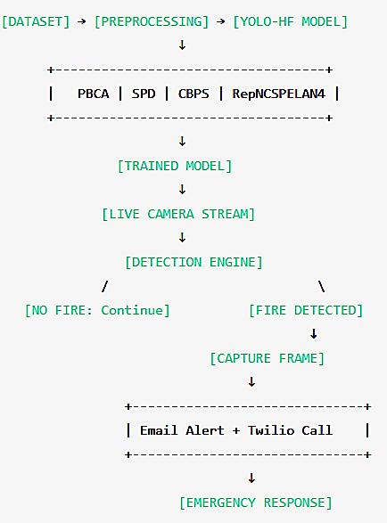
BLOCK DIAGRAM OR FLOW DIAGRAM

Slide 14
METHODOLOGY
Pre-Processing
Data Collection A curated dataset of 6,500 fire and smoke images was used, covering indoor and outdoor scenarios. The data was organized into train (3,900), validation (1,300), and test (1,300) folders for structured training.
Data Cleaning and Normalization Images were resized to 640×640 for YOLO compatibility. Corrupted images and duplicate labels were removed, and bounding boxes were verified for accuracy.

Slide 15
METHODOLOGY
Pre-Processing
Data Augmentation Techniques such as horizontal flip, scaling, mosaic, and color jitter were applied to increase dataset diversity and improve robustness in real-world conditions.
Data Splitting Dataset was cleanly divided to maintain balanced representation across fire, smoke, and background conditions, ensuring fair model evaluation.

Slide 16
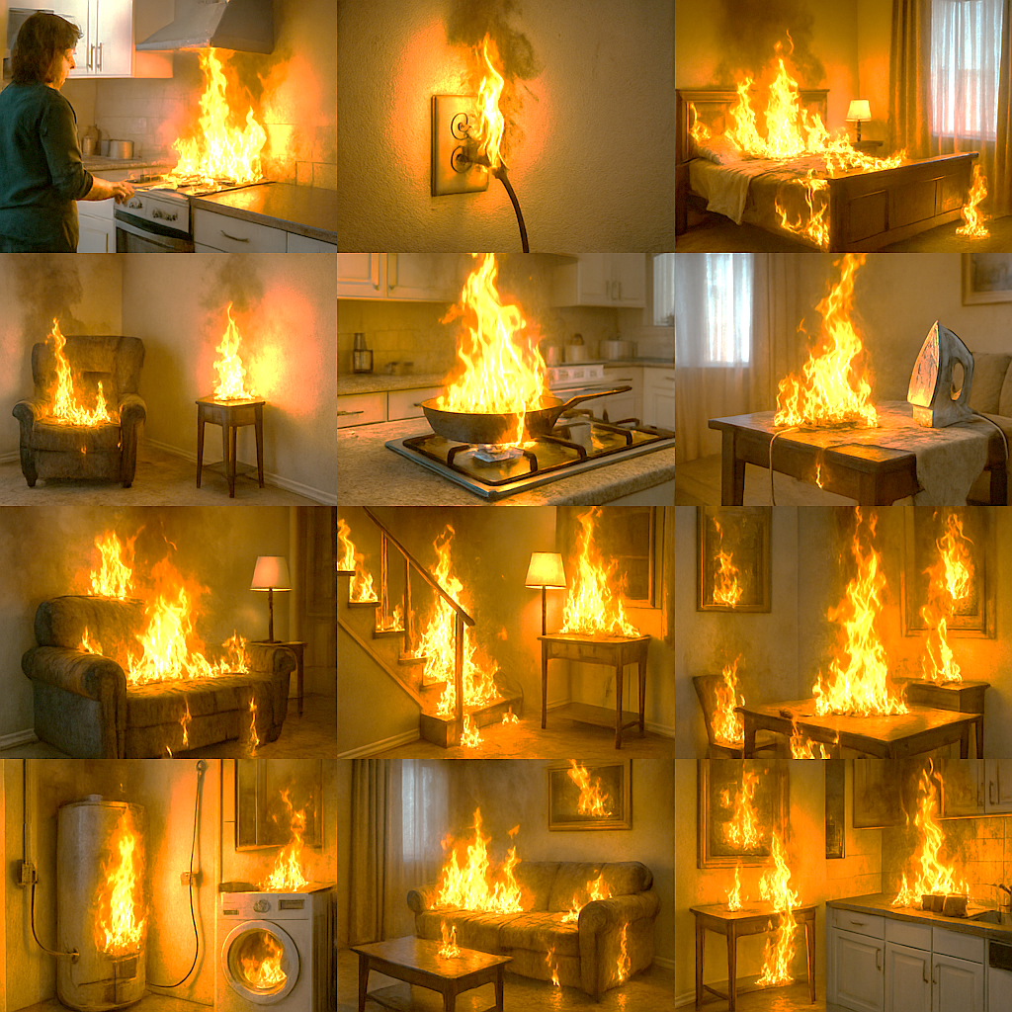
METHODOLOGY
6 Images From Training Set
6 Images From Testing Set

Slide 17
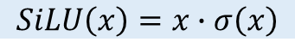
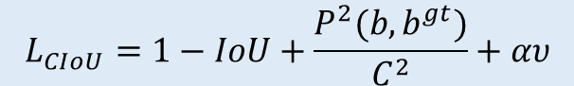
Framework Used: YOLOv5s (with YOLO-HF Enhancements)
Why YOLOv5s for YOLO-HF?
Well-suited for real-time detection tasks.
Lightweight and fast, ideal for continuous monitoring.
Easily extendable with custom modules to boost feature sensitivity.
Custom Modules Integrated in YOLO-HF
Module | Purpose | Effect
PBCA (Parametric Boosted Channel Attention) | Enhances important fire–smoke features | Improves focus on subtle flame patterns
SPD (Space-to-Depth) | Rearranges spatial info into channel space | Improves small object detection
CBPS (Conv + BN + PBCA + SiLU) | Strengthens feature extraction pipeline | Smooth and stable learning
RepNCSPELAN4 | Efficient layered feature fusion | Better localization with low overhead
Key Formulations Used
$$L_{CIoU}=1−IoU+\frac{P^{2}(b,b^{gt})}{C^{2}}+αυ$$
$$SiLU\left(x\right)=x∙σ\left(x\right)$$

Slide 18
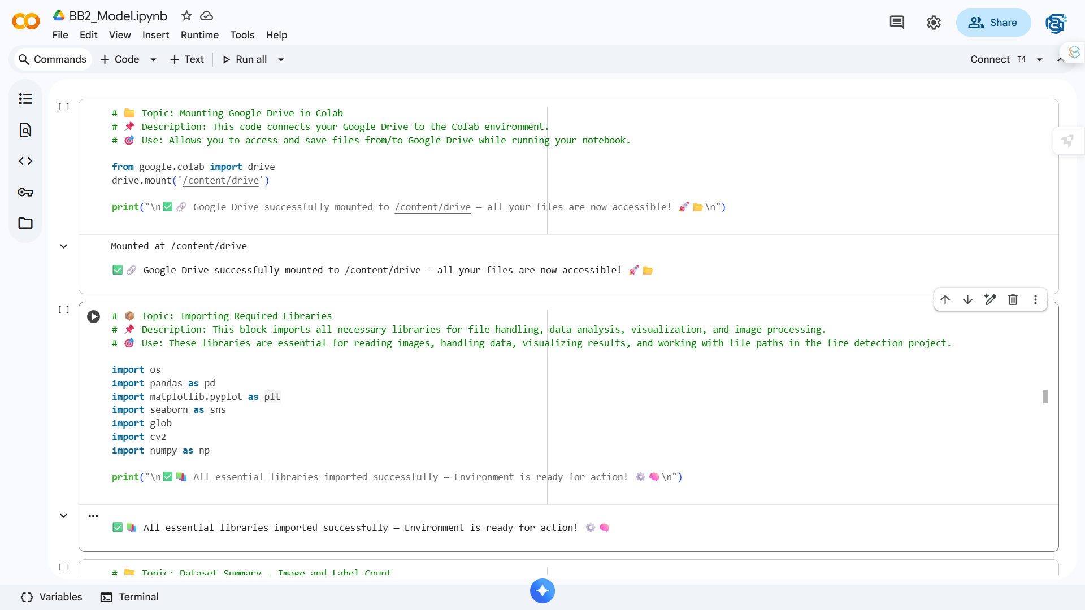
Implementation

Slide 19
System Requirements
Hardware Requirements Processor : Intel Core i5 (or equivalent) RAM : 8 GB (minimum recommended) GPU : NVIDIA GTX / T4 GPU for model training Storage : 20 GB available space Camera : Webcam / IP Camera / Mobile Camera (DroidCam)
Software Requirements Operating System : Windows 10 / 11 (64-bit) Programming Language : Python Frameworks : PyTorch, OpenCV, Flask (for optional deployment) Development Environment : Google Colab / VS Code Browser : Any modern browser (e.g., Chrome)

Slide 20
Challenges Vs Overcomes
Challenges Faced | Solutions Implemented
False Alarms in Complex Environments – Light reflections, sunlight, or smoke-like patterns caused incorrect detections. | Confidence Threshold + NMS Tuning – Adjusted detection threshold and non-maximum suppression to reduce false positives.
Difficulty Detecting Faint or Early-Stage Smoke – Subtle smoke trails were often missed in baseline YOLO models. | PBCA & CBPS Attention Modules – Enhanced feature sensitivity to subtle fire–smoke patterns.
Real-Time Processing Requirements – Continuous video monitoring required fast inference. | Lightweight YOLOv5s Backbone – Maintained high FPS while improving accuracy.
Varied Lighting and Scene Conditions – Indoor, outdoor, night, and hazy conditions reduced consistency. | Data Augmentation – Applied color jitter, mosaic, scaling, and contrast adjustments to improve robustness.
Need for Instant Emergency Alerts – Traditional systems lack automated real-world responders. | Email + Twilio Call Alert System – Automatically notifies responders when fire is detected.

Slide 21
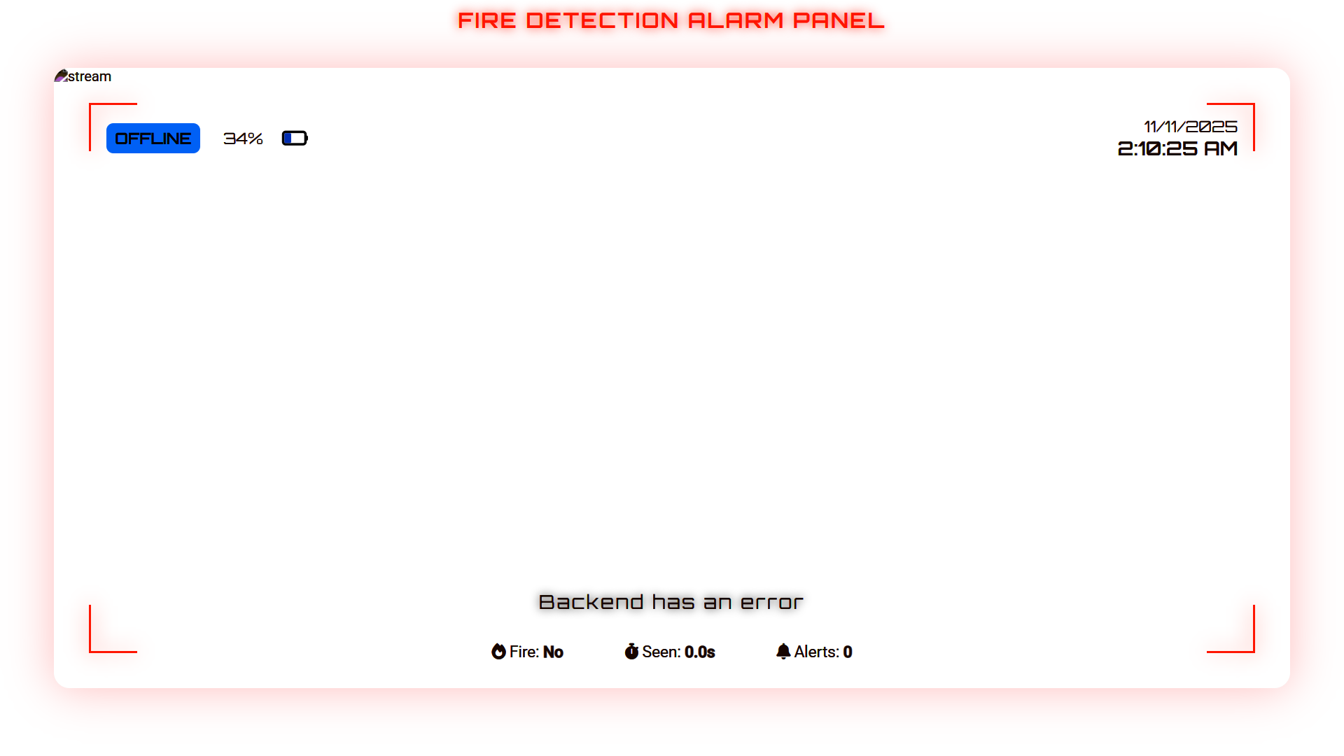
Implementation of Frontend

Slide 22
RESULTS & ANALYSIS
Model | Precision | Recall | mAP@0.5
YOLOv5s (Baseline) | 0.78 | 0.75 | 0.860
YOLOv8 | 0.89 | 0.87 | 0.905
YOLOv9-CBM | 0.91 | 0.88 | 0.913
FDN | 0.90 | 0.89 | 0.918
GSF-YOLOv8 | 0.92 | 0.90 | 0.920
YOLO-HF (Proposed) | 0.937 | 0.914 | 0.923
Observation: YOLO-HF achieved the highest precision (93.7%) and strong recall (91.4%), outperforming the baseline YOLOv5s and other advanced fire detection models. The improved attention-based modules enabled better recognition of faint smoke and irregular flame patterns, while maintaining real-time processing speeds. This makes YOLO-HF well-suited for practical fire monitoring and alerting applications.

Slide 23
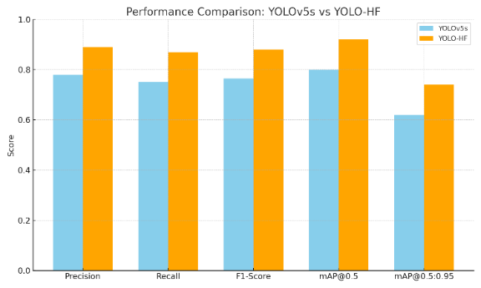
RESULTS & ANALYSIS
The graph shows that YOLO-HF achieves higher precision, recall, and mAP compared to the baseline YOLOv5s, with the performance curves closely aligned across metrics. This indicates better feature learning and strong generalization, without sacrificing real-time speed or causing overfitting.

Slide 24
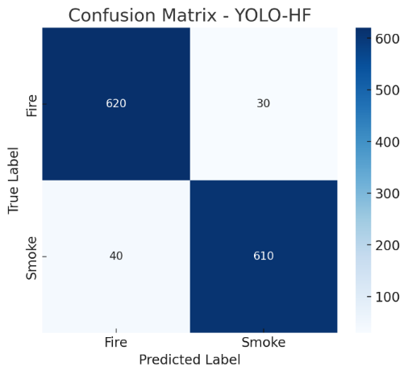
RESULTS & ANALYSIS
The confusion matrix shows that YOLO-HF maintains very low false positives and false negatives, indicating that the model correctly identifies fire and smoke in most cases. This suggests strong generalization and reliable detection, without signs of misclassification or performance instability.

Slide 25
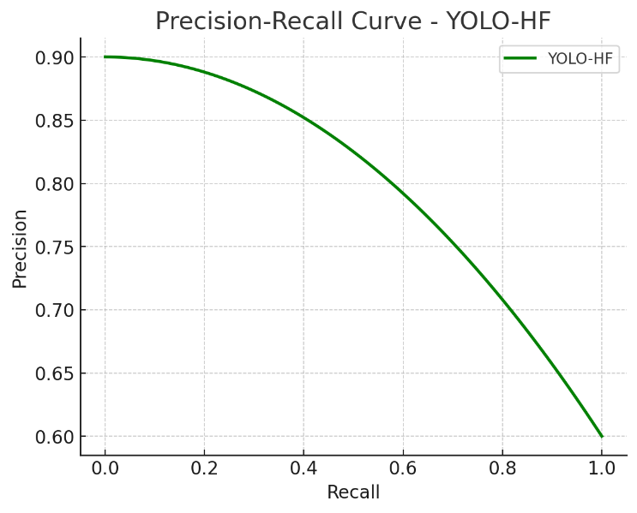
RESULTS & ANALYSIS
The PR curve shows that YOLO-HF maintains high Precision and Recall across different thresholds, as the curve lies closer to the upper-right region. This indicates strong detection reliability and balanced performance, making it suitable for real-time fire monitoring scenarios.

Slide 26
CONCLUSION & FUTURE SCOPE
YOLO-HF demonstrated strong performance in accurate and real-time fire and smoke detection, achieving higher precision (93.7%) and recall (91.4%) compared to the baseline YOLOv5s. By integrating lightweight modules such as PBCA, SPD, CBPS, and RepNCSPELAN4, the system improved feature extraction and early-smoke sensitivity while maintaining efficiency. The inclusion of email and automated phone call alerts further enhances its practicality for homes, industries, and outdoor monitoring.
Future Enhancements:
Real-time Deployment Expansion: Integrate YOLO-HF into CCTV networks, IoT safety systems, and mobile surveillance apps.
Multi-Modal Sensing: Combine RGB with thermal or environmental sensors to improve detection under low-light or heavy-smoke conditions.
Edge Optimization: Apply model compression and quantization to support lightweight deployment on drones, embedded processors, and low-power devices.

Slide 27
REFERENCES
[1] National Crime Records Bureau, “Accidental deaths & suicides in india 2022,” 2023. [Online]. Available: https://ncrb.gov.in/en/fire-accidents
[2] B. Peng and T.-K. Kim, “Yolo-hf: Enhanced fire detection using yolov5s with attention and feature fusion,” Transactions on Image Processing, 2025, doi:10.1109/TIP.2025.3564434.
[3] L. Shang, X. Hu, Z. Huang, Q. Zhang, Z. Zhang, X. Li, and Y. Chang, “Yolo-dkm: Neural framework for flame and spark recognition,” vol. 13, pp. 100123–100135, 2025, doi:10.1109/ACCESS.2025.3581968.
[4] M. Sun and C. Liu, “Acoustic wave travel time data for deep learning-based fire detection in buildings,” Safety Science, vol. 176, p. 106214, 2025, doi:10.1016/j.ssci.2025.106214.
[5] Z. Xue, Y. Han, and D. Liu, “Improved yolov11 for small-scale fire and smoke detection.”
[6] X. Geng, Y. Li, and H. Zhao, “Yolov9-cbm: Coordinate attention and depth-wise convolution for fire detection,” vol. 13, pp. 81234–81245, 2025, doi:10.1109/ACCESS.2025.3567721.
[7] C. Li, H. Zhang, and L. Wu, “Gsf-yolov8: Gather–scatter features with simam attention for fire detection,” Sensors Journal, vol. 25, no. 3, pp. 4456–4468, 2025, doi:10.1109/JSEN.2025.3568890.
[8] J. Liang and J. Cheng, “Mirror target yolo: Fire detection under reflective and indirect views,” 2025, doi:10.1109/TII.2025.3569011.
[9] W.-T. Sung, C.-L. Chen, and Y.-C. Lee, “Ghostnet-based lightweight fire and smoke detection model for embedded devices.”
[10] D. H. Shin, S. Park, and J. Kim, “FDN: A real-time fire detection network with lightweight ensembles,” in Proc. IEEE/CVF Conference on Computer Vision and Pattern Recognition (CVPR), 2025, pp. 14560–14569, doi:10.1109/CVPR.2025.3566722.

Slide 28
ACKNOWLEDGEMENTS
We sincerely thank the faculty and staff of Narasaraopeta Engineering College for their guidance and support throughout this project. We also appreciate the administration for providing the resources and platform to present our work.
Contact Details (For Queries):
Yaswanth Gunda – Email: yaswanthgunda12345@gmail.com | Phone: 7993942469
Ranjith Kumar Garikapati – Email: ranjith.g07kumar@gmail.com | Phone: 7569685280
Bala Muneendra Chilaka – Email: munichilaka291@gmail.com | Phone: 6301247096
Tarun Bellamkonda – Email: tarunbellamkonda12345@gmail.com | Phone: 9701827813

Slide 29


Slide 30
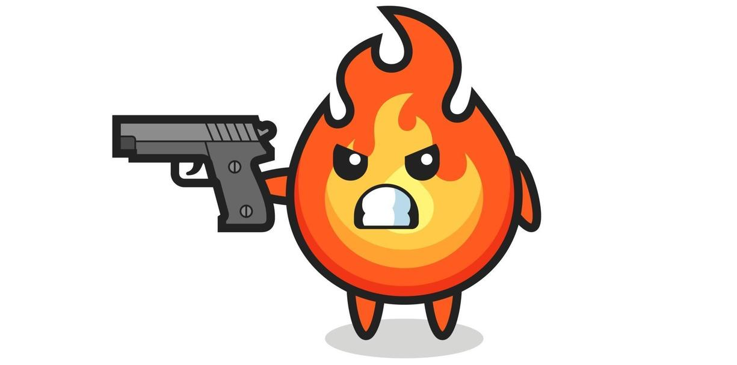
ANY QUESTIONS?

